Slide 1
Planning and Planting Your Garden
Allegheny Mountain Institute Farm
at Augusta Health
Grayson Shelor and Tess Jacobson

Slide 2
Before we begin…
Have a drawing, picture, or mental image of your garden space
Colored pencils, pens, pencils
Graph or plain paper
Notebook
Make sure you can see the notes section of the slides!
Notes:
These are recommended supplies that may aid you on your journey to planning and planting your garden. Make yourself comfortable somewhere and just let yourself dive into this information and make the most out of unlimited access to these resources!
To get to the links that are in the slides or in notes, hit ctrl + click to open the website.
All the names under CHECK THIS ATTACHED HANDOUT correspond to files that are in the zip file that was sent to you.
CHECK OUT THESE ATTACHED HANDOUTS:
Planning Vegetable Garden Basics.pdf
Home Garden Basics.pdf

Slide 3
Goal Setting
5 words for your future garden at its best
What does it need? What do you have to give?
Notes:
This is a great first step before you start planning out your garden space. What do you want from your garden and what are you going to need to give it in order to accomplish that? Answer these “Big Picture” questions and the ones on the slide to get a better understanding of what you want from your garden, before we dive into the details.

Slide 4
Site Planning
Factors for Consideration (mapping out)
Boundaries
Geography e.g. slope, land features
WATER
Wind patterns
Existing infrastructure or plants
Sun
Patterns of Use
Soil Type/Health
Notes:
Considerations are SUPER important when planning out your garden! Take these factors into consideration when you do start planning. What I like to do is look over these factors, thinking about how each of these come into play in my garden, before I map out my garden. Then I like to go out to my garden and physically map it out (I like to go to scale, but you don’t have to if you don't have the patience or time) on a piece of paper. I then like to add these factors onto the map, to describe how they play into your garden and will influence it. E.g. Where the sun rises and sets in comparison to your garden and where the sun is at its height, also where the shade is, can determine where you plant your shade-tolerant versus sun needing plants. How can each of these factors influence your garden? Take some time to think these over. Are there any factors that are missing that should be addressed for your garden?
CHECK OUT THESE ATTACHED HANDOUTS:
Planning Vegetable Garden Basics.pdf
Home Garden Basics.pdf

Slide 5
Sample Base Map
Notes:
This process is called base mapping, and it is adapted from the discipline of Permaculture. The example above comes from a home permaculturist’s blog: Shoestring Sustainability. You can read more about the process of creating the map from Shoestring Sustainability at https://shoestringsustainability.wordpress.com/2017/10/30/creating-a-permaculture-base-map/
Note the labels demarking boundaries (the property lines; fencing), slope, sunlight, wind, noise, water retention, obstacles (like the sewer line), and concerns for human use, such as the fact that certain areas of the property have no privacy, and those that have attractive views. All of these analyses will come into play as the gardener plans how to use the space.
Only planning a small space, and not your entire property? You can still use this process! In the next slides, we’ll look at several common models for vegetable gardens, each of which benefits from consideration under the site mapping framework.

Slide 6
The Options: In Ground Rows
Notes:
There are many options of how to use your garden space and how you can plant/organize your plants! The next few slides will go through those different options and the pros and cons of each.

Slide 7
The Options: In Ground Rows
Pros:
You already own the soil
Easy to expand or change the layout of your garden.
With a decent soil, these are very easy to dig and prepare.
Makes good use of the vast resource of water and nutrients provided and stored in the existing soil.
Cons:
Needs a site with workable, uncontaminated soil.
Vulnerable to pest and weed pressures
Unsuited to renters or small spaces
Notes:
If you own your land and have a significant area to dedicate to your garden, in ground rows are likely to be the most prolific of your options. However, they also represent a more sizeable investment of time, and stooping low to the ground can contribute to wear and tear on the gardeners’ body.
Consider a plot of in ground rows in the context of your base map.

Slide 8
The Options: Raised Beds

Slide 9
The Options: Raised Beds
Pros:
More control over soil quality
Versatility: can be made of different materials and dimensions to accommodate preferences or mobility challenges
Lower weed pressure
Cons:
Can be expensive to build/purchase and fill with soil
Edges can make digging or soil preparation awkward
Notes:
Raised beds present a more customizable option, and, tended carefully, can still produce a wealth of vegetables.
Bear in mind you won’t be moving these beds once they are filled with soil, so the spot you choose for your raised bed should still be subject to site analysis using your base map.

Slide 10
The Square Foot Method
Pros:
High productivity
Diversity
Easy start-up
Cons:
Gets cramped
Lots of water
Long-term maintenance becomes challenging
Notes:
Square Foot gardening is a subset of the raised bed model. Its benefits include guidance to plan highly diverse raised beds, and a wealth of resources in print and online. However, in the long term, planning a healthy crop rotation to combat pest and disease pressure can be daunting in a square foot garden.
-Here is a great resource for square foot gardening: https://squarefootgardening.org/
-How do I get started with the square foot method?: https://squarefootgardening.org/method/

Slide 11
The Options: Container Gardening
Notes:
Containers are incredibly adaptable, and can be created from many mediums, including reused household discards like these plastic buckets. Make sure they're able to drain properly, though!

Slide 12
The Options: Container Gardening
Pros:
Can be used on top of asphalt or where there is no soil.
Small containers or containers on wheels can be
moved inside to protect from weather or vandalism.
Good for areas with limited space.
Cons:
Requires initial cost of container and/or purchased materials to construct the containers. Can be costly.
Requires special soil mix that must be purchased or made from purchased ingredients.
Containers need to be watered and fertilized more often than in-ground beds.
Notes:
The biggest challenge with container gardening is that you cannot take advantage of the resilient, nourishing network provided by healthy, living soil. That means your container plant is entirely reliant on you to moderate its water and nutrition. It can be a little fussy to get that balance just right. Confusingly, most experts on container gardening recommend “Soilless Mediums” such as potting mix or a container gardening blend. These products contain ingredients like coconut coir or peat moss to help retain moisture inside your container.
Already have soil? Use the next step to give it a check up.

Slide 13
Is your soil healthy?
Observe your soil:
Soil Test (expensive)
Currently growing
Critters
Amend Soil:
Compost
Nutrients
Minerals
Kelp
Fungi
Notes:
Observing your soil is one of the best ways to understand the health of your soil. Use your senses to truly observe it: its smell, the way it looks, how it feels, etc. (We don’t recommend you taste it!)
Soil tests are incredibly useful to understand how healthy your soil is, and to know what you may need to add to your soil to make it healthier. But they can be expensive and are not a necessity for a home gardener. There are other ways you can observe the health of your soil. What naturally grows in your soil? "Weeds" can be an indicator of your soil and what it has or is lacking.
Here is a link to a website that goes through weeds and their indications of the soil they're growing in: https://www.almanac.com/news/gardening/gardening-advice/weeds-indicator-plants
Another way to tell how healthy your soil is by looking at the critters within it. Are there an abundant number of earth worms? Do there seem to be other insects and of fungal growth and life within the soil?
If there is, your soil is most likely very healthy! If not, how can we get your soil there?
There are many ways you can amend your soils, a great and healthy way to do this is by adding more compost or organic matter to your soil. (1-2 inches of compost added to top of soil, if planning to amend. Only ¼-½ inch if just putting as top soil.)
Organic Matter Resource: https://extension.oregonstate.edu/news/add-organic-matter-improve-garden-soils
CHECK OUT THESE ATTACHED HANDOUTS:
Choosing a Soil Amendment.pdf

Slide 14
Growing your soil
Basic principles:
Low to no soil disturbance (minimal tillage)
Plant/vegetation diversity
Keep soil covered
Living roots
Notes:
Here is a good resource to understand the basic principles of growing your soil, specifically slides 8-21:
http://extension.missouri.edu/sare/documents/soilhealth.pdf
This is a short video that talks about many of these basic soil principles. It focuses on farmers, but shows the watcher how and why each of these principles are important: https://www.nrcs.usda.gov/wps/portal/nrcs/detail/national/organic/?cid=nrcseprd1363633
One key component of keeping your soil healthy is to rotate your crops from year to year. It is helpful to learn your plant families, and avoid planting the same crop or a family member in the same soil two years in a row, since the two crops will likely draw on the same nutrient resources. A healthy rotation can relieve pest and disease pressure, and keep your soil fertile!
Here are some resources on crop/plant rotations: https://www.motherearthnews.com/organic-gardening/gardening-techniques/healthy-soil-crop-rotation-zmaz10fmzraw
https://www.groworganic.com/blogs/videos/garden-planning-crop-rotation

Slide 15
What to Plant?
What do you want to eat?
Matching conditions, timing, and neighbors for the best success rate
Amount of maintenance plant/crop needs
Notes:
Now let’s focus on the exciting step of planting your crops! For the AMI team as vegetable farmers, the first and most essential question is always about the end use. Are you craving fresh kale for salads? That cherished heirloom tomato you can’t find at the grocery store? Hot peppers for your famous canned salsa?
CHECK OUT THESE ATTACHED HANDOUTS:
Planting Date Planner.pdf
Plant Spacing Table.doc
Harvest Manual.pdf
Disease Management.pdf
Companion Planting.pdf

Slide 16
Zones
We are here: zone 6b
Notes:
If you’re our neighbor in the Shenandoah Valley, we’re fortunate to live in a wonderful environment for growing most annual vegetable crops. It’s crucial to know your zone, because zones quantify the impact of climate on plant choice and timing. Once you find your zone, you can know when it will be safe to plant vulnerable crops without worrying a hard freeze will take them out, and you can chart your desired crops over your full garden season.

Slide 17
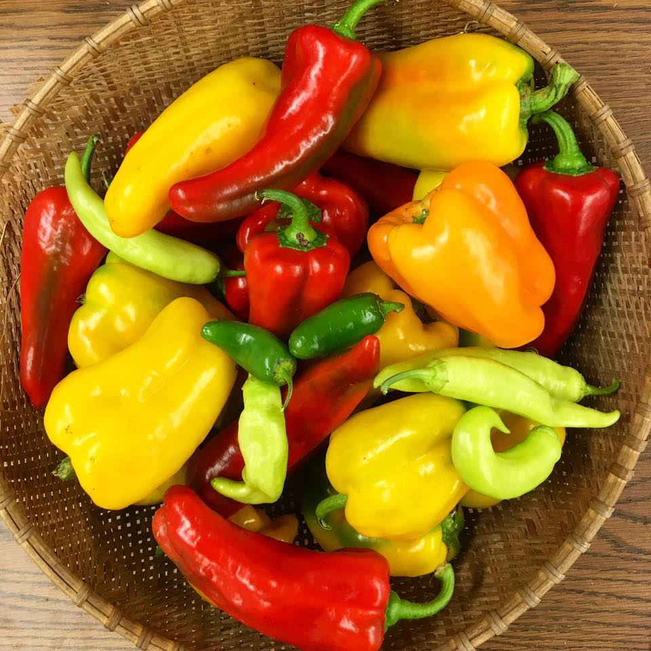
Choosing Your Crops
Spring & Fall
Kale, Peas, Lettuce, Spinach
Summer
Beans, Peppers, Tomatoes
Notes:
Factors that affect regional crop success include soil type, climate, humidity, rainfall, and etc. You can moderate some of those factors by choosing your timing wisely.
You can use season extension tactics to grow things that might ordinarily not fit the zone, or to grow them at a different time of year, but it takes more energy and has a lower rate of success (ex. Ginger and Turmeric). The loose examples above reflect best practices from the AMI farms to grow healthy crops with minimal energy investment. Keep in mind that for many crops, the further you push them from their natural growing conditions, the more vulnerable they become to certain pests and disease.
For example, I CAN grow lettuce in August, but to keep it cool enough to prosper, I will be watering it far more frequently, consequently creating the perfect conditions for slugs to move in and munch.
CHECK OUT THIS ATTACHED HANDOUT:
Planting Date Planner.pdf

Slide 18
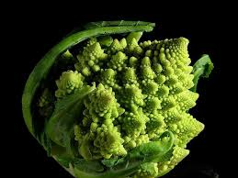
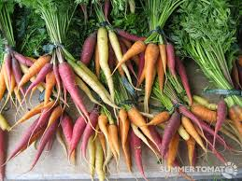
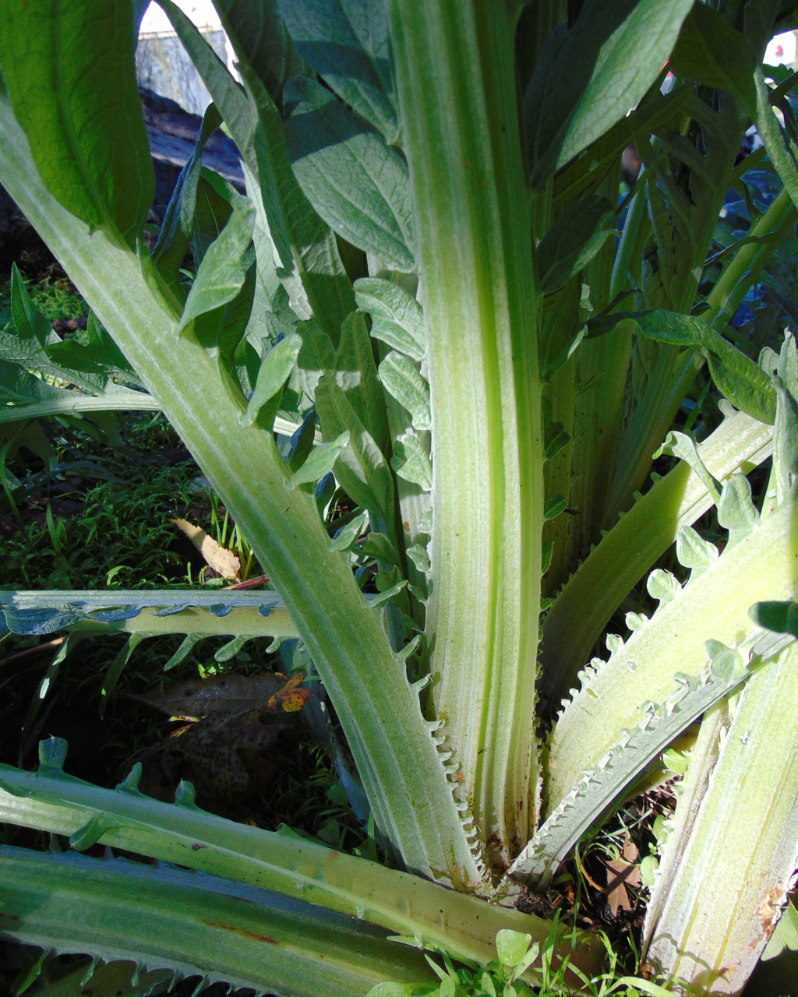
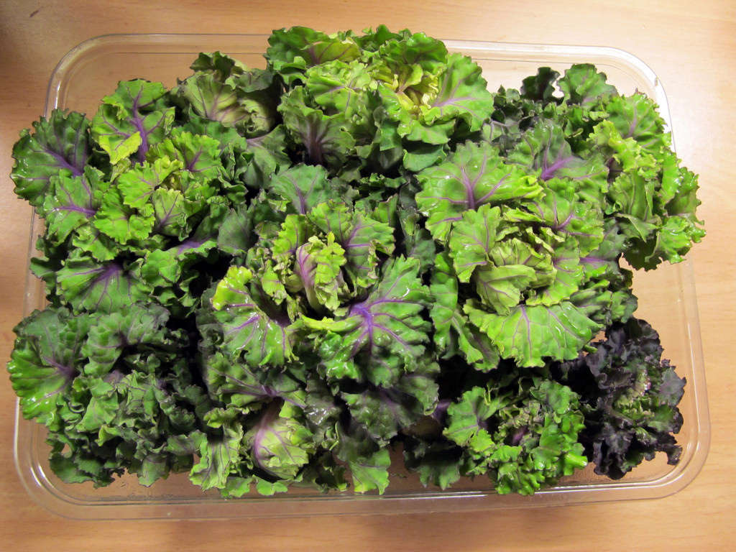
Choosing Your Varieties
Notes:
There is so much more to vegetables than the varieties we grew up with! Pictured, clockwise from top left, Romanesco; Rainbow Carrots; Cardoon; Kalettes; Purple Cauliflower.
Have fun with choosing your varieties! Use seed catalogues or seed packets to compare the qualities each has to offer. For example, certain varieties of Kale are particularly cold hardy, making them great choices for high altitudes or late plantings.

Slide 19
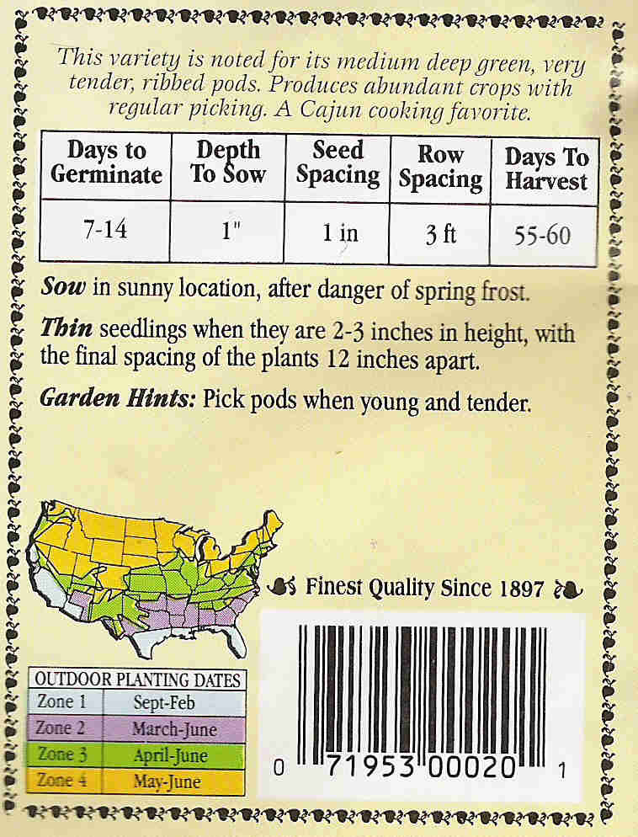
Reading the Seed Packet
Transplant vs. Direct Seed
Seed spacing vs. Row spacing
Remember, May 15!
Old seeds…
Notes:
Your key tips for success are at your fingertips with advice direct from the seed companies. Don’t forget, May 15th is the safe date to escape a late frost in the Shenandoah Valley.
We highly recommend using the resource of your local seed library to get started. Do bear in mind though, the older a seed, the lower its germination rate is likely to be.
CHECK OUT THIS ATTACHED HANDOUT:
Plant Profiles Worksheet.pdf (so you can keep track of the many varieties of plants you’ll be growing!)

Slide 20
Timing
Frost Dates:
Last Spring Frost: May 15th
First Fall Frost: October 10th
Seed Starting and Transplanting vs. Direct Seeding
Notes:
Know your frost dates, use this resource to look your frost dates up: Dave's Garden
Another resource to know timings for seed starting and planting in general: Mother Earth News
When deciding what to start in flats and later transplant or to direct seed, a lot of it depends on the type of plant and even how you're using it. E.g. Beets versus tomatoes or lettuce heads versus leaves. Read your seed packets carefully, as they will give you a good recommendation on which to do, and also when you start planting.
CHECK OUT THESE ATTACHED HANDOUTS:
Planting Date Planner.pdf
Harvest Manual.pdf
Seed Starting.pdf

Slide 21
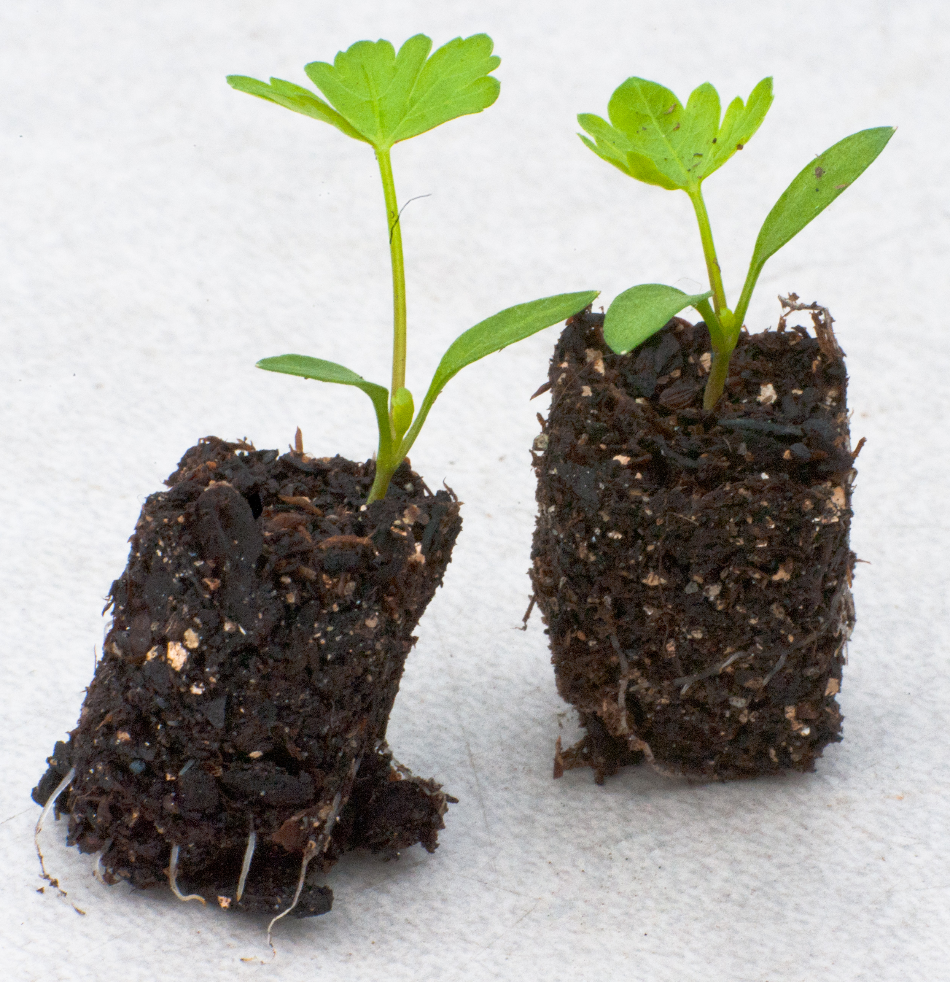
Seed Starting and Transplanting
Some crops have a distinct preference- check your seed packet
Germinating seeds like it warm and moist, but leaves need sunlight. Not too deep!
Happy transplants need a gentle transition to the wider world
Sunlight, wind, cold
Cover to here
Watch for binding
Well Watered
Notes:
Again- CHECK YOUR SEED PACKET, to understand what is best for your plants/seeds.
CHECK OUT THIS ATTACHED HANDOUT:
Seed Starting.pdf

Slide 22
Good Neighbors
Notes:
Some plants love to be planted around others! Use our companion planting guide in the zip file to know which plants are good with each other.

Slide 23
Time to Design!
Remember:
Your environment (sunlight, wind, rain)
Your time
Your budget
Plan for the future (design to rotate)
Notes:
Now it's your time to plan your garden! Good Luck! I hope this resource was helpful to you!

Slide 24
Coming Soon…
Ergonomics in the Garden and Farm-ONLINE WORKSHOP
Online Workshop with Tiffany Holliday, Occupational Therapy student from Mary Baldwin University.
Thurs. April 9th, 10:30-11:30 AM
Reserve your ticket at https://ergonomics_farming.eventbrite.com
Gardening Small-DIGITAL LEARNING
Tuesday, April 28th
Digitalized learning materials will be sent to participants
Reserve your ticket at https://gardeningsmall.eventbrite.com
Other online classes and demos will be added soon. . . Keep an eye out on our website: www.amifellows.org

Slide 25
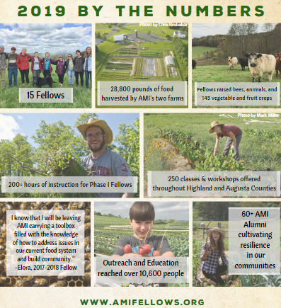
Allegheny Mountain Institute (AMI) seeks to build healthy communities through food and education. We accomplish this mission through our educational Farm and Food Fellowship, along with the AMI Farm at Augusta Health: a farm to hospital initiative that nourishes and teaches the hospital and community.
Notes:
Want to get in touch with Tess and Grayson, your instructors? Use the Feedback and Question Form for any follow-up questions you’d like answered from this course. Email us at Tess@amifellow.org or Grayson@amifellows.org if you’d like to learn more about Allegheny Mountain Institute, our mission, programming, and the AMI Farm at Augusta Health. And check out www.amifellows.org for more interactive classes! Additional courses will be added as they are created. You can also follow us on facebook and Instagram to stay up to date with all things AMI!

